Slide 1
Principles of Taxation
Sebastian James
World Bank

Slide 2
What are the goals of Tax Policy?
What are the goals of Fiscal (Tax and Expenditure) Policy?
Public Goods, Regulation, Social goals, Fiscal stabilization, Political Economy, etc.
Should we work on Expenditure enhancements/reductions versus reduction/increased Tax collection?
Both expenditure reductions and tax increases impose costs on society
Once we have identified that increased Tax collection are needed, do we:-
improve efficiency of existing tax instruments (is tax policy the issue or tax administration)?
change the rates and bases of existing tax instruments?
use new tax instruments?
What are the different tax policy options?
What Taxes to Levy?
How much?
On Whom?
How do we evaluate the different policy options?

Slide 3
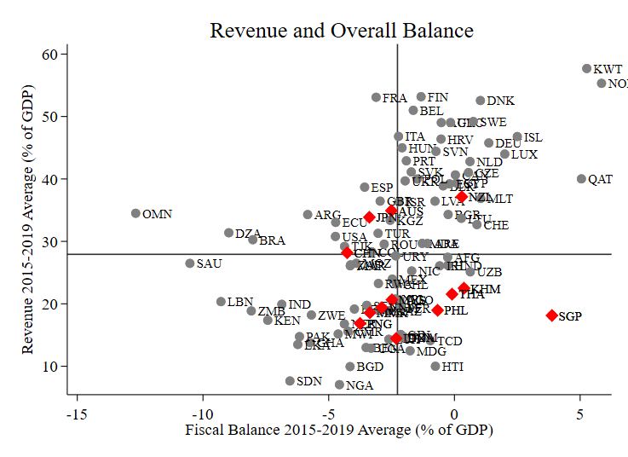
Tax Policy Performance w.r.t spending - Revenue vs Fiscal Balance
Example – Malaysia occupies the High (-ve) Fiscal Balance – Low Revenue quadrant

Slide 4
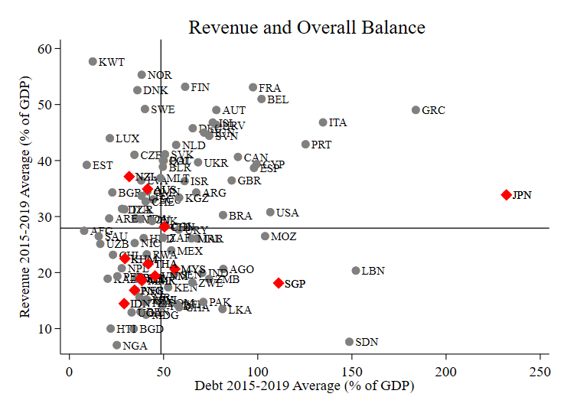
Tax Policy Performance w.r.t spending - Revenue versus Debt
Example – Malaysia is in the High Debt - Low Revenue quadrant

Slide 5
Principles of financing public sector and Sources of revenue Taxation, User Charges and Donations/ Community financing
Principles of financing public sector
Types of revenue
Types of taxes
Market differences in three types of revenues
Taxation
User charges
Voluntary donations or Community financing: Not paid to government but may serve same purpose

Slide 6
Principles of financing public expenditures(1)
BENEFIT PRINCIPLE – those who benefit from services should pay.
Applied to goods or services where exclusion of non-payers is feasible. Trying to finance government like a private business. Not applicable to pure public goods.
User charges: where government provides “private” goods and services, it can charge fees and apply marginal cost pricing rules (for equity or externality considerations however, prices kept below MC).
User charges reflect the benefit or willingness to pay for the good or service received. Costs of producing such goods and services can be recovered from user charges, at least in part or only to cover costs of operations and maintenance, just like the private sector.
Many government functions or services are not suited to user charges, then taxation is the only option.

Slide 7
Principles of financing public expenditures (2)
ABILITY-TO-PAY PRINCIPLE – Where not feasible to charge Marginal Cost of public service to beneficiary, raising public finance cannot follow benefit principle – in such cases source and use of finance become delinked.
Ability to pay principle then becomes the dominant principle -financing charges or taxes should be borne in line with ability to pay the tax irrespective of particular benefits received.
All taxes are typically designed primarily to follow the “ability to pay” or income of the taxpayers. Payment not linked to benefits received from public services.

Slide 8
Types of revenues
TAXES
Includes administrative cost recovery charges (license or permit fees) where no private benefit from service of registration/licensing
NON-TAX REVENUE
CHARGES FOR SERVICES -- tolls, user charges fall in this category
INCOME FROM PROPERTY-- rentals, property sales, loan redemption
CHARGES FOR RIGHTS – fee for use of property, royalty (including natural resources)
FOREIGN AID and OTHER DONATIONS
Grants (on or off budget)
Loans with some concessionary element (at least 25%)
International/National/Community based financing (off budget)
DEBT FINANCING
FOREIGN DEBT
Commercial or concessional debt
DOMESTIC DEBT -- private savings/investment; inflationary financing
REVENUE or ASSET SECURED BONDS

Slide 9
Types of taxes
Direct and Indirect
Direct taxes have a real or legal entity as subject of the tax: income and wealth; typically charges on factors of production (labor, capital, land)
Indirect taxes target transactions such as international trade, sales, contracts, etc.; typically charges on market transactions of goods/services
Major tax bases
Income
Consumption
International trade (declining with GATT/WTO reductions in trade taxes)
Rents -- natural resources, including land

Slide 10
Tax versus price or user charge for supply of goods or services
TAX
Involuntary (legally sanctioned) transfer of resources to public sector. Tax captures a share of market surplus by raising the price paid in a market above the full cost of supply. Private sector has to cover costs to be still willing to supply – tax has to be over and above this minimum cost.
USER CHARGE
Voluntary transfer of resources to public sector in exchange for service (charge is fixed or “involuntary” but voluntary choice in use of service.) User charge is paid by beneficiary and covers all or part of the cost of supply of a good or service to beneficiary. Beneficiary is willing to pay all or part of gross benefit derived from purchase. Quite similar to private goods.
Note: Administrative cost recovery fees are taxes as no benefit related to fee. e.g., fee for issuing passport or registering a company.

Slide 11
Taxes vs User Charges
Tax finance
Costs to economy of raising revenues include compliance and administrative costs plus economic efficiency cost. Typically marginal cost of public funds could be as high as 20% to 30% of tax revenue. These costs will be discussed and defined when covering taxes.
User charges
Cost of collection borne by respective agencies and departments. User fees revenues should be included in the respective budgets. User fees remove low value demand with MB < MC, but possible loss of surplus to poor users or loss of positive economic externalities.

Slide 12
Principles of Taxation: Evaluating a Tax
Is the Tax Equitable? (EQUITY PRINCIPLE)
Does the Tax distort Economic decision making? (EFFICIENCY PRINCIPLE)
Can the Tax be collected with least cost? (ADMINISTRATIVE SIMPLICITY)
Other principles to keep in mind and related to the above
Stability of Revenues
Neutrality
Ability to Pay and Benefit principle
Principle to keep in mind – Taxes are a by-product of Private Economic Activity (with some exceptions) – Typically forgotten by those working on Tax

Slide 13
Estimating the Revenue Impact of policy Options?
What is the potential tax that can be collected?
What part of the tax base has been exempted by policy measures (policy gap)?
Tax expenditure estimates are needed
What part of the tax is not collected as a result of imperfect compliance (compliance gap)?
Tax gap needs to be estimated
What is the elasticity of the tax base to the rates?
Estimates includes elasticity of investment to the user cost of capital
Elasticity of FDI to tax rates for different kinds of FDI
What is the role of tax policy to address market failures?
Estimating the social returns to investment versus the private financial returns for different kinds of investment
This analysis applies to all taxes
Income Tax
Customs Duty
VAT
Excise
Property Tax
Royalty (extractive industries)

Slide 14
What can we Tax, How and Why?
Base/Tax Handles | Instrument | Equitable? | Efficient? | Easy to Collect?
Wages | Payroll Tax | No | Yes (if rates are reasonable) | Yes (No from self employed)
Income (Personal) | Personal Income Tax | Yes | Yes (if rates are reasonable) | Yes (No from self employed)
Income (Legal person) | Income Tax (Corporate) | Yes | No for marginal investments | Yes (Except for foreign income)
Consumption | VAT | No | Yes | Yes
Imports | Import Duty | No | No | Yes
Immovable Assets | Property Tax | Yes | Yes | No
‘Bads’ | Excises | No | Yes (- ve way) | Yes
Exports | Export Tax | No | Yes | Yes
Luxuries | Luxury Tax | Yes | Yes | Yes

Slide 15
Principles of Taxation: Evaluating a Tax
Question – How would you evaluate the following Tax Policy Change –
“The Government has created a new Simplified Tax for Small Businesses. These businesses will pay Income Tax of 2% of Turnover(Sales). These businesses do not have to maintain detailed books of accounts. The definition of Small Businesses are those with fewer than 20 employees. The Government believes that such a regime will greatly improve tax compliance.”
PS. Regular sized businesses will pay income tax at 30%. It is known that average profit margins are 10% of Sales.

Slide 16
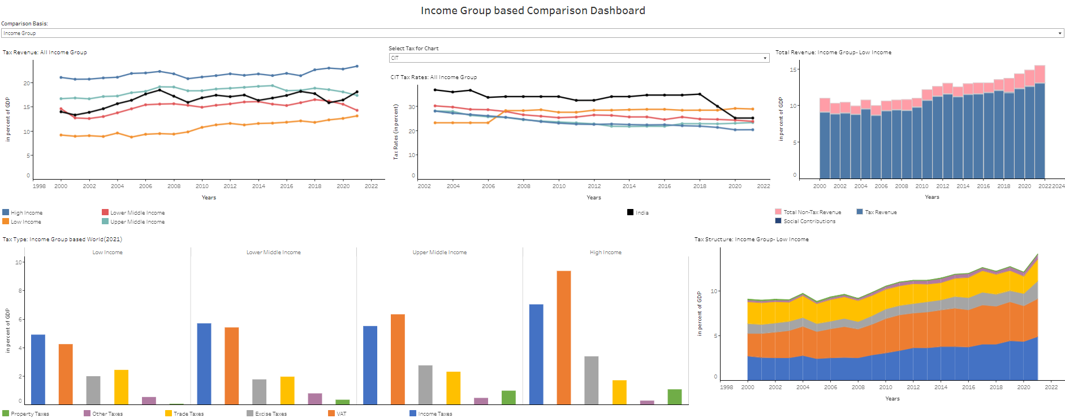
Recent Trend in Total Revenues by Income
Revenue Dashboard
World Bank Revenue Dashboard

Slide 17
Evaluating Tax Policy: More in-depth
Different Models used:
Macro/GDP-based
Micro-Simulation
CGE Models
Other Models
Optimal Income Tax Models, User Cost of Capital Models, METR, Tax Incidence Models, Tax Expenditure Models, Tax Gap Models, etc.

Slide 18
Macro or GDP-based model
Applicable to all tax types: VAT, Excises, income taxes and trade taxes.
Data requirement:
series of tax revenues, and
their bases (e.g., GDP, consumption or imports).
Steps:
Then, future changes in tax revenues are simply determined as the product of expected changes in the base and the buoyancy applied to GDP growth projections.

Slide 19
Micro-simulation model
Applied typically to direct income taxes (PIT, CIT) when database computerized. Distributional impact of policy change can be qualified.
Data requirement: Individual income tax returns and the appropriate PIT/CIT tax provisions.
Steps:
Sampling of tax returns (Stratified sampling).
First, different strata are established on the basis of some critical categories such as size of assets, income, industry, or region. Firms in each stratum resemble by the category used to select the strata.
Second, sample of firms/individual taxpayers selected from these strata.
Data cleaning and completion.
This step is to ensure consistency and reliability of data selected for the simulations.
Filling in missing data relies on either data from corporate financial statements, individual tax filings, and/or imputation data.
Construct a tax calculator to simulate PIT/CIT.

Slide 20
US Treasury Department Microsimulation Model estimates of Tax Reform Proposals

Slide 21
Growth and taxation
What is the impact of Taxation on Investment and Growth?
The role of Tax Incentives
What are the revenue costs of tax incentives (Tax Expenditures)
What are the fiscal multipliers?
Measures the effect of a $1 change in spending or a $1 change in tax revenue on the level of GDP
The literature says that the multipliers for Emerging Market Economies are small and hence not very effective
There exists hierarchy in terms of the damage that different taxes do:
Those taxes that directly affect investment and labor are the most damaging tax from the point of view of growth and employment (corporate tax on marginal investments, personal income taxes if very high)
Import duties on investment goods affect the cost of investment
Taxes on consumption are less distorting to growth, VAT and import duty on consumption items
Property taxes on residential property has a lower impact on growth in the short run than the other taxes

Slide 22
Globalization and taxation
How has Globalization affected tax?
Trade taxes become less important as a revenue raising instrument.
Globalization exerting downward pressure on CIT and PIT.
Tax competition
Base erosion and profit shifting induced by cross-border transaction.
Transfer pricing.
CFC-shifting tax base outside of the country of residence.
The US: companies parking profits overseas ‘perpetually.’
Globalization complicating further and eroding the VAT base.
Treatment of services and intangibles.
E-commerce.

Slide 23
Topics in Tax Policy
Taxation and Efficiency | Personal Income Taxes | Tax Competition and Harmonization
Taxation and Equity | Taxation of Business Income | Revenue Forecasting
Tax Incidence | Corporate Income Tax | Minimum Taxes
General Equilibrium Models | Capital Gains Tax | Taxation of the Financial Sector
Taxation and Risk taking | Tax Incentives | Taxation of Mineral Resources
Taxation and Savings | Cash Flow Taxes
 | Payroll Taxes and Social Security
Optimal commodity Taxation | Asset and Wealth Taxes
Sales Tax/Turnover Taxes | Taxation of Land and Property
VAT
Excise Taxes | International Trade Taxes
User Charges | Taxation of Income – International Tax issues
Environmental Taxes | Tax Treaties
 | International Transfer Pricing

Slide 24
Foreign aid
Community is now wider. Revenues are derived from donor country taxes out of donor country surpluses. Also private foreign voluntary giving (e.g. Gates funding).
Donor support is typically motivated by:
Humanitarian giving
Development of recipient country yields “donor satisfaction” and possible gains from improved environment and trade (mutual gains)
Strategic gains out of international co-operation from recipient nation

Slide 25
How Taxation helps Government Fulfill its Agenda?
Governments need revenues in order to perform their functions.
Provide goods and services that the private sector fails to supply (market failures and public goods – monopoly, national security, legal system, public parks, etc.)
Correct market imperfections (externalities – pollution, public health, public education, etc.)
Taxation helps complete the rest of the Agenda too:
Improve distribution of wealth and skills in society and promote equity.
Stabilize markets and avoid both inflation and recession, using fiscal (taxation) and monetary policies (interest rate) to reduce risks to investors.

Slide 26
Progress with DRM in Low and Middle Income Countries (LICs and MICs)
Since the 1980s, average government revenues in developing countries, both low income countries (LICs) and middle income countries (MICs), have been increasing.
But private sector still not quite strong and the present levels of domestic revenues fall short of what is needed to support a more robust development agenda in countries where poverty is high and socio-economic disparities are quite acute.
Countries with some of the lowest revenue-to-GDP ratios are also those where most of the world’s extremely poor live - India, Bangladesh, East Africa Community and Nigeria – they all have tax-GDP ratios around or below 15%.
Source: IMF

Slide 27
New Emphasis on Domestic Revenue Mobilization (DRM)
The sustainable development goals or SDGs (post-2015 development agenda) espoused in the 2015 summit of the UN member states have replaced the millennium development goals (MDGs). They address the dual challenges of eradicating global poverty and protecting environment.
The Intergovernmental Committee of Experts on SDG (UN) has estimated the cost of providing a social safety net to eradicate extreme poverty to be about US$66 billion a year, while annual investments in improving infrastructure could be US$7 trillion globally. It clearly raises the development finance goals “from billions to trillions”.
Developing countries, particularly LICs, used to rely on public international finance to fund their development agendas. However, only five OECD donors met the UN’s target to spend 0.7 percent of their gross national income on official development assistance (ODA), and the ODA reached only to $135 billion in net terms at its peak amount in 2013.
Even if the annual ODA level were to double, the developing countries will still face a huge financing gap to fund the SDGs.

Slide 28
Recent Emphasis on DRM (Contd.)
So the Intergovernmental Committee concluded that resources generated from the private sector, through tax reforms and a crackdown on illicit financial flows (Base Erosion and Profit Shifting - BEPS) and corruption, are vital.
This has finally led to the realization that there are no easy alternatives and ultimately strengthening of domestic revenues is the answer.
During the United Nation’s Addis Ababa “Financing for Development Conference (FFD)” in July 2015, a new reality that the development finance has to come from the households, corporate actors and the governments – seemed to be accepted by all participating nations.
Thus domestic resource mobilization (DRM) has reemerged as the key source of funding national development plans for developing and emerging economies.
The goal to “transform the world by 2030: agenda for SDGs” is both attractive and desirable, but this further raises the bar for all the nations, particularly LDCs. The topic of DRM, with taxation at its core, is now clearly back on the global front burner.
Notes:
BEPS is base erosion and profit shifting. This started with multinationals but has been adopted by domestic companies as well.

Slide 29
Domestic Resources and Development: Centrality of Taxation

Slide 30
Reasons for Low Domestic Revenues or a ‘Tax Gap’ in Developing Countries?
Following are the possible reasons for a continued revenue gap in low income countries in particular and developing countries in general:
Existing tax capacity and revenue mobilization opportunities not exploited fully
Lack of a good tax system including taxation of natural resources; and poor exploitation of other non-tax revenue sources
Low tax effort due to weak tax administration and low levels of compliance by domestic taxpayers
Aggressive tax planning by businesses using tax shelters, transfer pricing etc. leading to Base Erosion and Profit Shifting (BEPS) especially in international taxation
Lack of political will (??)
We start by examining the key principles and practices of a good tax policy followed by tenets of a modern and effective tax administration.

Slide 31
ABILITY TO PAY AND BENEFIT PRINCIPLES IN TAXATION
“Ability-to-pay” principle -- those with a higher ability to pay should bear a larger burden of tax. “Ability to pay” generally equated with income. This is the rationale behind progressive income taxes.
“Benefit” principle -- those who benefit from public services should pay for it. Applied to goods or services where exclusion of non-payers is feasible, for instance user charges that reflect the benefit or willingness to pay for the good or service received. Costs of producing such goods and services and operating/ maintaining them can be recovered from user charges just as in the private sector.

Slide 32
PRINCIPLES OF TAXATION (2)
EQUITY -- Tax system should be “fair”; two components
HORIZONTAL EQUITY
"Tax equals equally”; those under same circumstances pay the same tax
Demands broad coverage by a tax base
Source of much of the detail and complexity of a tax law required to define a comprehensive tax base and deal with all the exceptional circumstances & cases
VERTICAL EQUITY
Demands that a larger tax burden is placed on individuals with a greater capacity to pay in order to "improve" the income distribution in society. Society-wide social judgments depend upon and arise out of the political process.
"Ability-to-pay" principle -- those with a higher ability to pay should bear a larger burden of tax.
"Ability to pay" generally equated with level of income (control over economic resources).
"Larger burden“ interpreted as a larger share of overall tax burden.
A progressive tax structure has higher income persons paying a higher share (higher percentage) of their income in tax.

Slide 33
PRINCIPLES OF TAXATION (3)
ECONOMIC EFFICIENCY
Transfer of resources (or removal of market surplus) to public sector, called tax burden, always involves an added cost to the economy or excess burden or added loss of surplus that arises out of distortions in price system caused by taxes.
Taxes not only reduce the size of the private sector, but also change prices (wage rates, interest rates, goods prices, etc.) in the economy which results in changes in PATTERNS of consumption, savings, work effort, investment and international trade compared to the pattern prevailing without taxes. Changes in patterns or ALLOCATION of economic resources causes an added cost on the economy.
Tax structures should be designed to collect a given tax revenue with a minimum excess burden or economic efficiency cost.
Generally high efficiency costs are related to high tax rates and to large differentials in tax rates:
The efficiency costs of taxes rise more than proportionately with the tax rate.
Large tax rate differentials between similar economic activities cause large efficiency costs.
This principle leads to reforms of tax structures such that LOWER and MORE UNIFORM TAX RATES are charged on BROAD TAX BASES. Broad coverage is also consistent with the principle of horizontal equity.

Slide 34
PRINCIPLES OF TAXATION (4)
TECHNICAL EFFICIENCY-- ADMINISTRATIVE or TRANSACTION COSTS
The administrative or transaction costs on the public and private sectors of transferring resources from the private to the public sector should be minimized in order to leave the maximum resources for the production of public sector and private sector goods and services. Two components:
"compliance cost" which refers to the costs of the private sector in complying with the tax laws, and
"tax administration cost" which refers to the public sector costs of administering the tax laws.
Excessive public spending on tax administration can be wasteful, but spending too little can also be economically wasteful for at least two reasons
Broad coverage is more equitable and allows collection of tax revenues at lower, more efficient tax rates.
To gain broad coverage of a tax base requires sufficient enforcement capacity.
Added administrative spending that educates the taxpayer and services their tax-paying needs can lower the economic transaction costs of complying with the tax.

Slide 35
PRINCIPLES OF TAXATION (5)
TOTAL ECONOMIC COST OF TAXES
In the beginning, the focus in design of taxes was on administrative feasibility and costs
But now the applied economic principles of allocative efficiency or economic efficiency costs of taxes have changed the focus to reducing these allocative efficiency costs of taxes as well
Now concern is to reduce combined transactions costs (administration plus compliance costs known as technical efficiency) plus allocative efficiency or economic efficiency costs of taxes or excess burden

Slide 36
PRINCIPLES OF TAXATION (6)
STABILITY OF REVENUES
The overall tax revenue structure of an economy should produce stable revenue flows so that fiscal deficits are predictable and manageable in order to
Avoid inflationary effects and/or "crowding out" effects on private investment from domestic debt financing and/or
Limit the need for foreign debt obligations due to excessive debt financing
Difficult to implement RAPID cuts in public expenditures or change tax laws or borrow or upgrade administrative capacity in response to a revenue crisis. Overall tax structure should be designed to avoid revenue crises.
REVENUE STABILITY has two components
REVENUE ELASTICITY: Revenues should grow at least as fast as GDP, otherwise new taxes and/or administrative measures must be constantly introduced to raise added revenues in each fiscal year to keep revenues at a constant share of GDP. Key tax structure issues: (i) a revenue base that grows with the economy and (ii) tax rates that tax at least a constant share of the growing base. Ad valorem tax rates (rates that tax a share of the value of a tax base) on a broad base required to ensure revenue elasticity.
REVENUE DIVERSIFICATION: Tax or revenue structure should be sufficiently well diversified to withstand shocks to the economy such as fluctuations in world commodity prices. Revenue diversification is hard to achieve in small economies that have high dependence on particular sectors or revenue sources.

Slide 37
Principles of Taxation (7)
Tax Neutrality
Refers to a tax policy environment where economic decisions are not affected or minimally affected by tax factors. That implies achieving a “level playing field” where the tax system does not favor one group of tax payers over another.
It basically argues against tax incentives and preferential treatments of particular groups of taxpayers or regions.
It has also been demonstrated that tax incentives are not cost effective, i.e. they do not necessarily bring more investments.
Tax incentives very common in developing countries, mainly due to “demonstration effect” – I have to give tax incentives as my neighbor does it! (SE Asia)

Slide 38
Tax Reforms – Types of Reform
Two major components
Tax policy/ structure which requires consideration of the different principles of a good tax system
Tax administration and compliance
Comprehensive reforms contain both components
Time frame and coordination important
Reforms could be revenue enhancing or revenue neutral
Gradual decline in importance of tax policy component as most countries have resolved many of the tax policy issues
In 1950s and 60s, goals of using income tax as tool of income redistribution led to very high top marginal tax rates (75% & higher) plus proliferation of tax incentives
1970s onwards – rationalization and reduction of rates.

Slide 39
Tax Policy Component (contd.)
Income tax rates: corporate and top personal income tax rates reduced to 25% - 45% range; incentives reduced and rationalized to some extent
VAT/GST on broad bases
Pressures from globalization and international competition to have “competitive tax system”
Growth of common markets and other trading blocs led to harmonization of rates
BUT ongoing pressures from lobby groups complicate taxes (Indonesia, India). With computer-based tax calculators, greater tolerance of complexity in tax systems possible but it is not desirable from the perspectives of revenue or economy
Import duty rates reduced steadily to minimal levels in industrial countries under WTO directives; similar trend elsewhere

Slide 40
Tax Reform in Practice
Before Reform | After Reform
DIRECT TAXES: (a) Personal Income Tax High Top Rates (up to 60%) Many Rates Many Exemptions | DIRECT TAXES: (a) Personal Income Tax Top Rates Falling (30-35%) Fewer Rates Fewer Exemptions
(b) Corporate Income Tax High Marginal Rates Tax Holidays and Other Incentives Double Taxation | (b) Corporate Income Tax Convergence with Top PIT Rates Elimination of Special Incentives Integration of Corporate and Personal Income Taxes
INDIRECT TAXES (a) Sales Tax Many Rates Many Exemptions Narrow Base | INDIRECT TAXES (a) Value-Added Tax One Positive and One Zero Rate Few Exemptions Broad Base + Selective Excises (e.g., fuels, cigarettes, liquor)
(b) Import Duties (Trade Taxes) High Tariff Rates Wide Dispersal of Rates Quantitative Control (quota) | (b) Import Duties (Trade Taxes) Top Rates Lowered Target of Uniform Tariff Trade Liberalization

Slide 41
Modern tax administration
Characterized by
Self-assessment
Electronic filing and payments
Computerization and Cross checking of taxpayer information
Selective audit
Functional administration, not by taxes but by functions
Requires
Clear laws, regulations, forms, etc.
Taxpayer information and education
Taxpayer services
Tax administration aims to lower costs of compliance
Structural requirements
Formal/modern sector
Accounting standards and practices

Slide 42
Modern tax administration (contd)
Tax compliance costs (mainly time costs) usually exceed tax administration costs
Tax administration costs usually range from about 0.5% to 3% of revenues collected around the world.
Depend upon tax rate, base type and size, efficiency of organization
Tax compliance costs often in range of 5% to 20%
Depend upon type of tax, size of taxpayer, tax rate, etc.
Total cost to economy equals costs of administration plus compliance plus cost of economic inefficiency
Cost reductions can be achieved by tax administration targeting at lowering of compliance costs (information, education, service, internet access, etc.)

Slide 43
Main Trends in Tax Administration Reform
Development of self assessment
O Risk assessment and selective audit
O Taxpayer education and service to lower compliance costs
Integration of direct and indirect tax administration – functional versus tax type administration
O Functional administration means that each administrative function – assessment, audit, collection, etc. is administered across all domestic tax types
Unified tax administration law – one law for all domestic tax types
Corporatization – establishing revenue authorities
Introduction of taxpayer segmentation, beginning with establishment of large taxpayer units (LTUs requires functional organization) to service clients
E-government

Slide 44
Principles of Taxation
Why the new emphasis globally on Domestic Revenue Mobilization (DRM)?
Is tax the only reliable and effective source of raising revenues in the long-run?
Principles of a good tax system: equity, economic efficiency, technical efficiency, revenue stability and tax neutrality.
Tax reform: Tax policy and tax administration
Tax capacity and tax effort
Tax buoyancy, elasticity and revenue forecasting

